Slide 1


AGENTIC AI | DATA ENGINEERING
The AI-in-Data Engineering Program
Program Overview · the two agents, end to end
Two agents on one governed
Databricks platform
August 2026
Proprietary and Confidential
Notes:
ACFC-formatted program overview. Architecture slides depict the target shape inside AmeriHealth's own Databricks account.

Slide 2

PROGRAM OVERVIEW
AGENDA
01
How the two agents fit together
One relay from an approved FRD through to generated pipeline code — with a human gate at each hand-off
02
STTM Agent Overview and Demo
The source-to-target mapping workbook, filled in from the approved FRD and returned to SharePoint
03
CodeGen /Data Engineer Agent Overview and Demo
04
Next Steps and Prioritize Agent Training and Deployment
2

Slide 3
TEAM INTRODUCTIONS
Dedicated POD for this program
Raj Gokaraju
Oliver Doren
Sponsor
Databricks Solution Architect
PARTNER/
CLIENT COUNTERPARTS
Reviews sample BRDs / FRDs / STTMs;
leads output acceptance and UAT sign-off.
Shares sample BRDs, FRDs and STTMs — the seed corpus for agent grounding.
HEXAWARE DELIVERY POD
Venu Anumolu/Ram Kuchana
AI Engineer 1 (Arjun Pillai)
AI Engineer 2 (Soham Banerjee)
Engagement Lead
Dedicated — 100%
Dedicated — 100%
FRD - STTM Agent ·
CodeGen / Data Engineer
Scope, plan, client alignment, solution architecture guidance and escalations.
2
Cadence: Daily pod stand-up · weekly client status · bi-weekly demos & SME checkpoints · monthly steering.

Slide 4
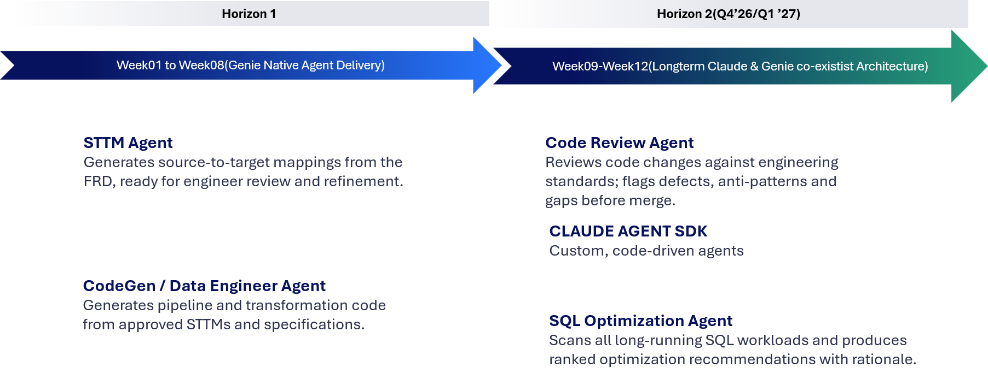
Agents Scope
Four agents, two waves — all live by Jan 31, 2026
AMERIHEALTH CARITAS | PROPRIETARY AND CONFIDENTIAL
4

Slide 5



THE PROGRAM AT A GLANCE
Two agents, one relay — from an approved FRD through to generated pipeline code
Agent 1
Agent 2
FRD
FRD → STTM
STTM
CodeGen
Pipeline code
approved,
in SharePoint
workbook,
in SharePoint
transforms, DDL,
tests, job config
human gate
human gate
The FRD is authored and approved by your team. Agent 1's workbook is Agent 2's input — and nothing moves downstream until a named person approves it.
FRDs and STTM workbooks are read from, and written back to, the AmeriHealth SharePoint document library through the Microsoft Graph API.
The AI only ever drafts
Every claim cites its source
A named person signs off
Validation, grounding, gating and rendering are all ordinary code. The model is never the arbiter of whether its own output is right.
A value that cannot be found word-for-word in the source document fails the run — it is never quietly invented or approximated.
Each agent stops at a review gate before its output moves on. Decisions are recorded and survive re-runs of the same document.
Where both agents run
Lakeflow Declarative Pipelines
Unity Catalog
Model Serving / AI Gateway
Databricks Apps
one pipeline per agent; each stage re-runnable
Delta tables and Volumes own every artifact
the Claude-family endpoint each agent calls
the review surface where a person decides
3

Slide 6




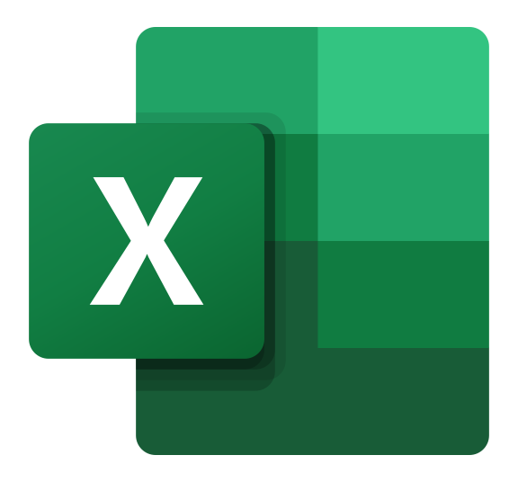








FRD → STTM Agent solution architecture
One connector layer reaches every source system · the model call runs through Unity AI Gateway · a reviewer approves the draft
Analyst starts a run
SOURCE SYSTEMS
Databricks review app · confirm-gated
SharePoint
GENERATED · DRAFT
FRDs and the approved STTM library
Draft STTM workbook
Connector layer
STTM Agent
.xlsx · client dialect · open questions flagged
Jira board
Databricks serverless job
four stages · one model call
Requirement stories & acceptance criteria
MCP services expose each system through one pattern
Confluence / other
Ingest
Extract
Audit · Gate
Render
Extensible — same connector pattern
MODEL ACCESS · GOVERNED RUNTIME
Auth for every connector
Unity AI Gateway
Entra ID app · OAuth · scoped read-only
routing · guardrails · rate limits · cost & audit on every call
Foundation Model APIs
Unity Catalog
The one model call — pay per token
Corpus · lineage · run history
ON APPROVAL
Human review — the approval gate
SharePoint — becomes a template for the next run
Reviewers resolve flagged questions, edit in Excel, and approve. Nothing moves downstream unapproved.
(optional) — publish the approved mapping to the catalog

Slide 7
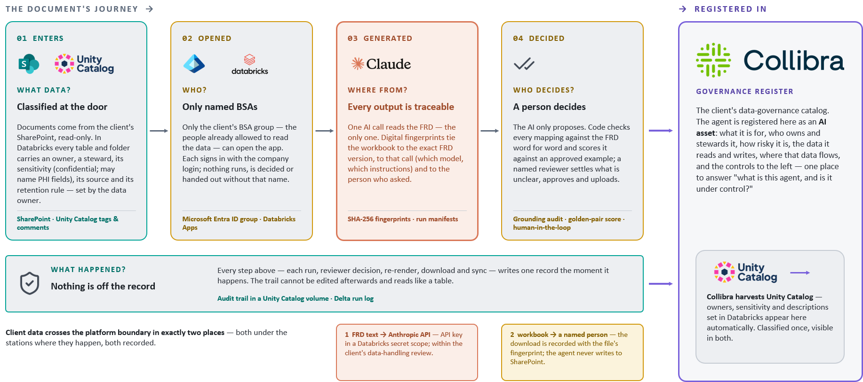
FRD → STTM Agent data governance architecture
2

Slide 8
STTM Agent Demo

Slide 9
THE PROGRAM AT A GLANCE
Two agents, one relay — from an approved FRD through to generated pipeline code
STTM
Agent 2
CodeGen
Pipeline code
transforms, DDL,
tests, job config
human gate
The FRD is authored and approved by your team. Agent 1's workbook is Agent 2's input — and nothing moves downstream until a named person approves it.
FRDs and STTM workbooks are read from, and written back to, the AmeriHealth SharePoint document library through the Microsoft Graph API.
The AI only ever drafts
Every outcome cites its source
A named person signs off
Validation, grounding, gating and rendering are all ordinary code. The model is never the arbiter of whether its own output is right.
A value that cannot be found word-for-word in the source document fails the run — it is never quietly invented or approximated.
Each agent stops at a review gate before its output moves on. Decisions are recorded and survive re-runs of the same document.
Where both agents run
Lakeflow Declarative Pipelines
Unity Catalog
Model Serving / AI Gateway
Databricks Apps
one pipeline per agent; each stage re-runnable
Delta tables and Volumes own every artifact
the Claude-family endpoint each agent calls
the review surface where a person decides
3

Slide 10






CodeGen Agent Architecture
The approved STTM becomes deployable artefacts — a PySpark notebook, or DDL and SQL for the existing ingestion framework
Engineer starts a run
GENERATED · DRAFT
SOURCE INPUTS
Databricks app · one approved STTM per run
OPTION A · NOTEBOOK
Approved STTM, FRD
PySpark notebook
Signed-off mapping from the STTM agent
Runs natively on Databricks
or
Connector layer
CodeGen Agent
OPTION B · INGESTION FRAMEWORK
Data Structures
Databricks serverless job
four stages · one model call
DDL scripts
Target schemas, DDL & naming standards
MCP services expose each system through one pattern
.xlsx · target table definitions
SQL insert statements
Collibra
Ingest
Generate
Test · Gate
Package
.xlsx · config rows for the framework DB
Glossary, classifications & data policies
MODEL ACCESS · GOVERNED RUNTIME
Reference code library
Unity AI Gateway
Merged pipelines ground future generations
routing · guardrails · rate limits · cost & audit on every call
Foundation Model APIs
Unity Catalog
The one model call — pay per token
Schemas · lineage · run history
Engineering review — the merge gate
ON APPROVAL
Notebook merged to the repo via pull request — usual SDLC controls
2
Engineers read the generated code, run it against test data, and approve. Nothing merges unreviewed.
DDL & SQL loaded into the existing ingestion framework database

Slide 11








HEXAWARE · AMERIHEALTH CARITAS · AGENT 02 / 03
CodeGen Agent data governance architecture
THE CONTRACT'S JOURNEY ↓
→ REGISTERED IN
01 ENTERS
WHAT DATA?
Generation reads only machine-readable contracts approved upstream — feed facts from the FRD, column mappings from the STTM. No raw client documents live in this repo; PHI fields arrive flagged and are masked to last-4 at every egress.
SharePoint read-only · frozen pydantic contracts
Approved STTMs and FRDs
GOVERNANCE REGISTER
02 OPENED
WHO?
SharePoint is reached as a registered Entra application with Sites.Selected on one site; writes are limited to a single output folder. Fetch and publish are explicit human steps — a re-generate is never a re-publish.
Microsoft Entra ID app · Sites.Selected · one write folder
The client's data-governance catalog. The agent is registered here as an AI asset: what it is for, who owns and stewards it, how risky it is, the contracts it reads, the code it writes, where that flows, and the controls to the left — one place to answer "what is this agent, and is it under control?"
Named identities only
03 GENERATED
WHERE FROM?
Deterministic templates render everything the contracts state — same contracts in, same bytes out. Only rule text code cannot map reaches the model; every citation must appear verbatim in the contract or the suggestion is marked ungrounded.
provenance banners · SHA-256 · verbatim grounding
Every file is traceable
04 DECIDED
WHO DECIDES?
The AI only suggests. Code computes each feed's verdict — PASS, PASS_WITH_FLAGS or FAIL — and model candidates land in a review file, never in generated code. A named engineer confirms flags, implements approvals, raises the PR.
gate verdict · candidates.json · human-in-the-loop
An engineer decides
WHAT HAPPENED?
Every generated file names the exact contracts and SHA-256 fingerprints that produced it; a per-feed report records every rule, its grounding, every model suggestion and the gate verdict.
Generated DDL is Unity Catalog-native — the Delta tables it declares carry owners and sensitivity, harvested into Collibra automatically. Classified once, visible in both.
Nothing is off the record
reports/<feed>.md · provenance banners · byte-stable renders
Client data crosses the repo boundary in exactly two places — both deliberate, both under the stations above, both recorded.
1 unmapped rule text → Anthropic API — mock by default: zero network without a key; the key lives only in the environment, never the repo.
2 artifacts → SharePoint — a separate, confirm-gated publish to one output folder; every file carries its provenance banner.
approved contracts · named identities · traceable files · an engineer decides · a record of everything
CONTROLS BUILT 2026-08-24 · COLLIBRA ENTRY PENDING
Notes:
Two-layer trust rule: templates write code; the model only advises on rules templates cannot cover.

Slide 12
STTM Agent Demo

Slide 13
NEXT STEPS
Prioritizing CodeGen agent to train on various frameworks and project specific templates.
  Ex: Ingestion framework, EDH Framework(aka V-query), CMS Framework
Engaging Architecture Team
Engage Platform Team
Engage AI COE
Deciding on SQL Server DB vs Databricks Lake base database for Audit or pipeline orchestration
Action Items
2

Slide 14

Thank you
Two agents. One governed platform. Every hand-off approved by a person.

Slide 15
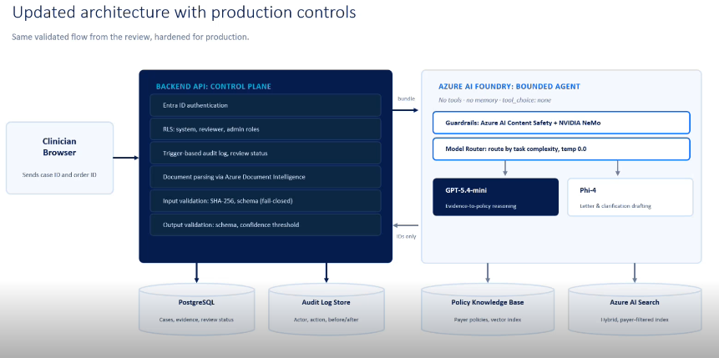
STTM Agent Demo

Slide 16
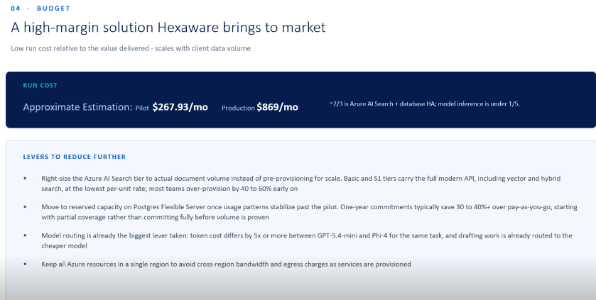

Slide 17
ARCHITECTURE
2

Slide 18



FRD → STTM Agent solution architecture
SYSTEM OF RECORD
Microsoft SharePoint
FRD_<name>.docx
STTM_<name>.xlsx
Entra ID app
Microsoft Graph
Sites.Selected · read
The client's document library — the only place anything is authored or approved.
input — approved requirements
input — becomes a template
00 sync on app start-up — imports every FRD_* / STTM_* not yet in Unity Catalog · never writes back
DATA PLATFORM
Databricks — Jobs run the pipeline, Apps serve the reviewer, Unity Catalog holds every file and table.
approved STTM goes back
Generation job Databricks Jobs · serverless · stages 01–04
Review app Databricks Apps
01
02
03
04
Volumes — FRDs, approved STTMs, the corpus index, every run's artifacts
frd_raw · sttm_reference · sttm_out
Delta tables — run history and contracts
Ingest
Extract
Audit · gate
Render
On start-up: syncs SharePoint → Unity Catalog. Then pick an FRD · run (confirm-gated) · answer what the agent could not settle · re-render · download.
docx → markdown
the one model call
verbatim grounding
STTM + contract
draft STTM .xlsx + feed contract .json → to a person
HUMAN REVIEW
OUTPUTS · DOWNSTREAM
The reviewer approves the STTM (edits in Excel if needed) and uploads it to SharePoint themselves. The next start-up sync pairs it — it becomes a template.
STTM workbook
.xlsx · client dialect
Feed contract
contract.json · machine-readable
CodeGen agent
Code Review agent
the model proposes · deterministic code audits and decides · a person resolves

Slide 19
HEXAWARE · AMERIHEALTH CARITAS · AGENT 02 / 03
HEXAWARE · AMERIHEALTH CARITAS · AGENT 02 / 03
CodeGen Agent solution architecture
CodeGen Agent solution architecture
THE PIPELINE →
THE PIPELINE →
SYSTEM OF RECORD
SYSTEM OF RECORD
GENERATION ENGINE
GENERATION ENGINE
HUMAN REVIEW
HUMAN REVIEW
OUTPUTS · DOWNSTREAM
OUTPUTS · DOWNSTREAM
codegen CLI offline · byte-stable
codegen CLI offline · byte-stable
Demo app FastAPI · React
Demo app FastAPI · React
Pipeline + notebook
PySpark · DDL · job · tests
Microsoft
SharePoint
Pipeline + notebook
PySpark · DDL · job · tests
Microsoft
SharePoint
Deterministic Jinja2 renders everything the contracts state; the model only sees what code cannot map.
Deterministic Jinja2 renders everything the contracts state; the model only sees what code cannot map.
Report + candidates
report.md · candidates.json
Pick a contract pair · run · read the gate verdict · approve / reject model candidates · publish behind an explicit confirm.
Report + candidates
report.md · candidates.json
The program's document library — approved contracts and workbooks in, generated artifacts out.
Pick a contract pair · run · read the gate verdict · approve / reject model candidates · publish behind an explicit confirm.
The program's document library — approved contracts and workbooks in, generated artifacts out.
Resolve
01
Resolve
01
FRD ⋈ STTM → frozen spec
FRD ⋈ STTM → frozen spec
Every file carries a provenance banner — the contract names and sha256 that produced it.
Every file carries a provenance banner — the contract names and sha256 that produced it.
FRD_<name>.contract.json
input — feed-level facts
FRD_<name>.contract.json
input — feed-level facts
Compile rules
02
Compile rules
02
The engineer decides
no-LLM classifier
The engineer decides
no-LLM classifier
Reason
03
Reason
03
Reads the verdict — PASS / PASS_WITH_FLAGS / FAIL — confirms flagged rules, implements approved candidates, and raises the PR. Nothing under out/ is ever hand-edited.
STTM_<name>.xlsx
input — column mappings
Reads the verdict — PASS / PASS_WITH_FLAGS / FAIL — confirms flagged rules, implements approved candidates, and raises the PR. Nothing under out/ is ever hand-edited.
STTM_<name>.xlsx
input — column mappings
Code Review agent
reviews what this agent emits — via an engineer-owned PR
the one model call
Code Review agent
reviews what this agent emits — via an engineer-owned PR
the one model call
Emit · gate
04
Emit · gate
Entra ID app · Microsoft Graph
Sites.Selected · one write folder
04
Entra ID app · Microsoft Graph
Sites.Selected · one write folder
Jinja2 → verdict
Jinja2 → verdict
The gate pre-flights its checks: ruff, debug scan, secrets scan, test-per-module, tests.
The gate pre-flights its checks: ruff, debug scan, secrets scan, test-per-module, tests.
mock by default · only unmapped rule text · suggestions land in candidates.json, never in code
mock by default · only unmapped rule text · suggestions land in candidates.json, never in code
00 sharepoint-fetch pull is explicit · publish is a separate, confirm-gated step · a re-generate is never a re-publish
00 sharepoint-fetch pull is explicit · publish is a separate, confirm-gated step · a re-generate is never a re-publish
gate verdict · candidates.json · engineer-owned PR
gate verdict · candidates.json · engineer-owned PR
PUBLISH BACK
PUBLISH BACK
sharepoint-publish — the engineer returns pipeline, notebook and report to the library's single output folder (file names qualified per feed). The write grant covers only that folder — and the next fetch reads the same library.
sharepoint-publish — the engineer returns pipeline, notebook and report to the library's single output folder (file names qualified per feed). The write grant covers only that folder — and the next fetch reads the same library.
artifacts flow back ←
artifacts flow back ←
deterministic code renders · the model only suggests · an engineer decides and ships
deterministic code renders · the model only suggests · an engineer decides and ships

